Slide 1



Extracting the Planckian scattering rate of the Strange Metal PdCrO₂ from Angular-Dependent Magneto-Resistance Measurements
Juan L. Santana González
Realized in:
Laboratoire des Solides Irradiés, École Polytechnique
Under supervision of:
Gaël Grissonnanche
M2 Internship Soutenance
International Centre for Fundamental Physics: Condensed Matter Track
July 2024

Slide 2
Table of Contents
Introduction: The Strange Metal and the Planckian scattering rate
Material: The isostructural delafossites PdCoO₂ and PdCrO₂
Approach: Angle-Dependent Magneto-Resistance and Chamber’s formula
Experiment: Electric transport in extreme magnetic fields
Results: Preliminary conclusions and Outlook
Conclusion

Slide 3
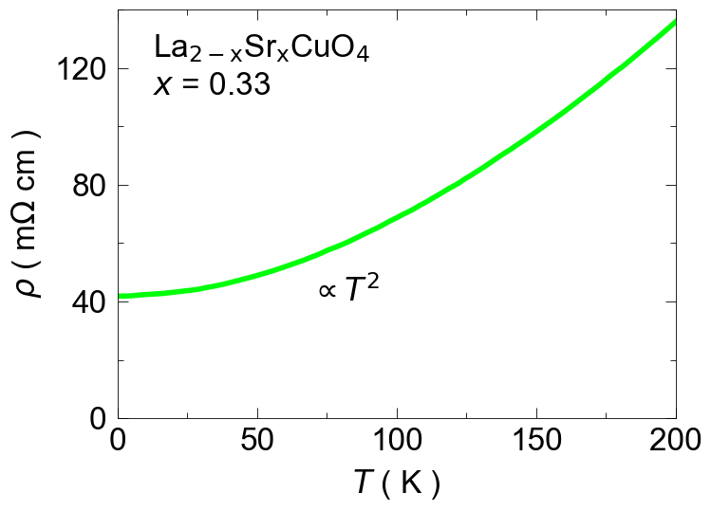
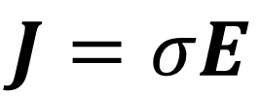
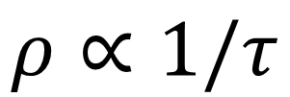
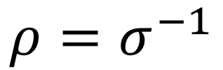
The conventional metal.
Nakamae et al. PRB 2003
$$J=σE$$
$$ρ=σ^{−1}$$
$$ρ∝1/τ$$

Slide 4
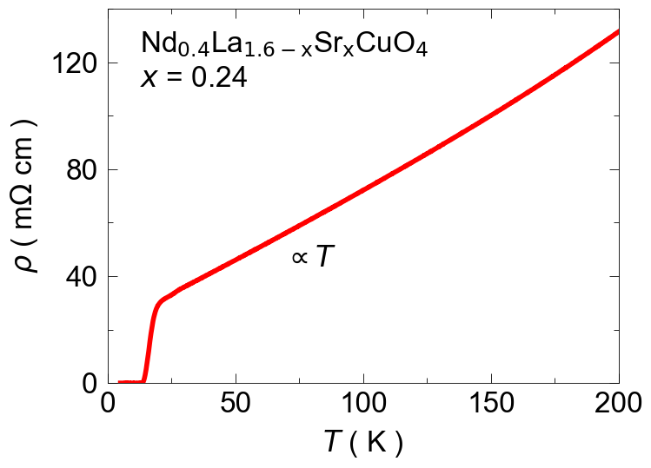
The conventional metal. What makes it strange?
Nakamae et al. PRB 2003
Daou et al. Nat. Phys. 2009
Superconductivity

Slide 5
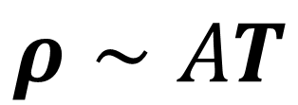
What does it tell us?
$$ρ∼AT$$

Slide 6
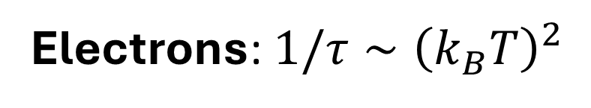
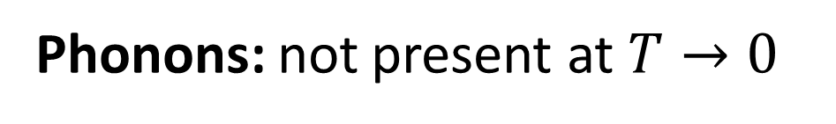
Unknown scattering process
Electrons: 1$/τ∼{\left(k_{B}T\right)}^{2}$
$$ρ∼AT$$
Phonons: not present at $T→0$

Slide 7
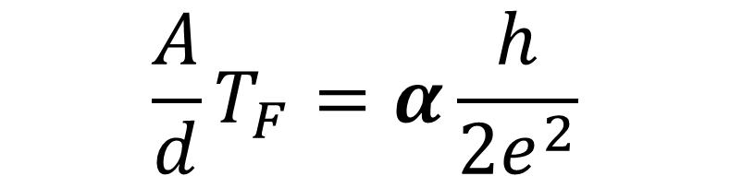
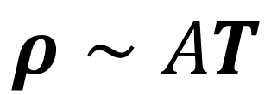
Universality
$$ρ∼AT$$
$$\frac{A}{d}T_{F}=α\frac{h}{2e^{2}}$$

Slide 8

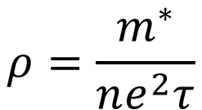
Universality
Universal (Planckian) Scattering Rate
$$ρ∼AT$$
$$\frac{A}{d}T_{F}=α\frac{h}{2e^{2}}$$
$$\frac{1}{τ }=α\frac{k_{B}T}{ℏ}$$
$$ρ=\frac{m^{∗}}{ne^{2}τ}$$

Slide 9
Universality
Planckian limit for the Scattering Rate
$$ρ∼AT$$
$$\frac{A}{d}T_{F}=α\frac{h}{2e^{2}}$$
$$\frac{1}{τ }=α\frac{k_{B}T}{ℏ}$$
$$ρ=\frac{m^{∗}}{ne^{2}τ}$$
Drude model in Quantum Materials? We want to do better

Slide 10
Where can we find them?
Daou et al. Nat. Phys. 2009

Slide 11
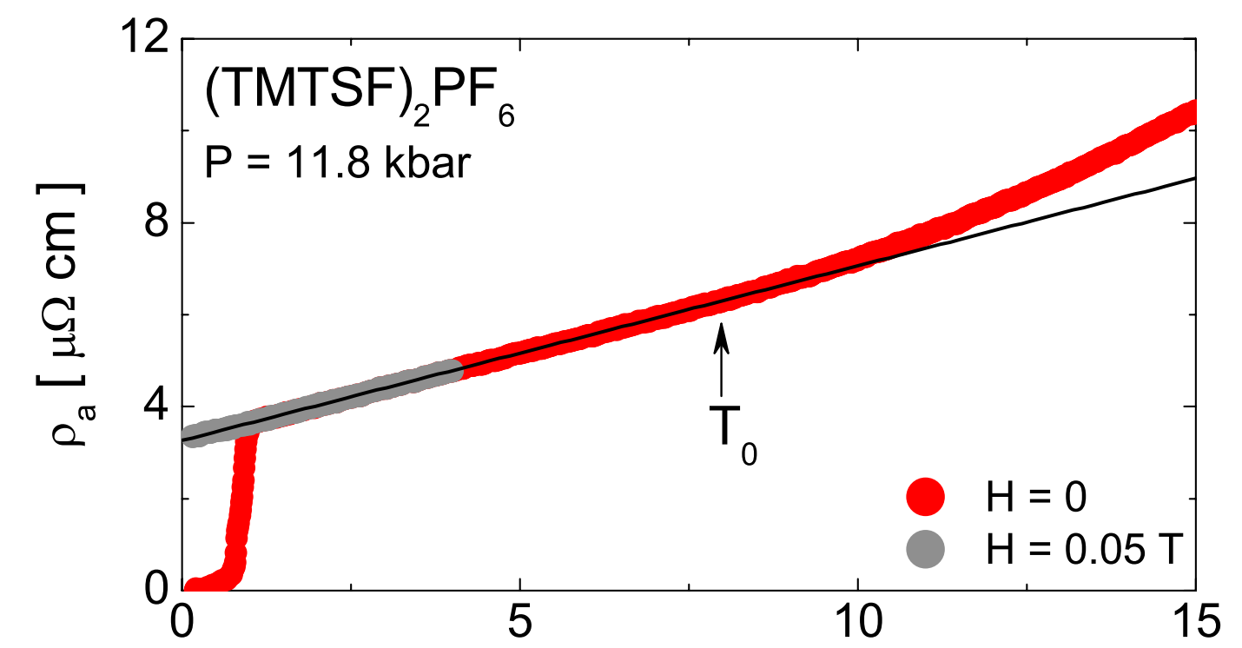
Where can we find them?
Doiron-Leyraud et. al. PRB 80, 214531

Slide 12
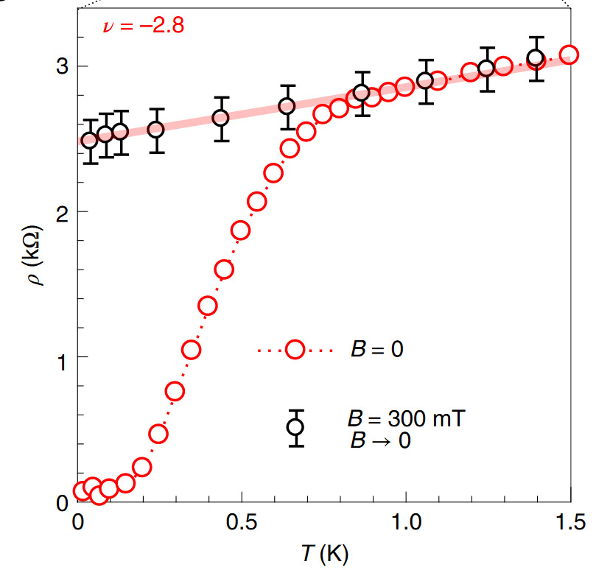
Where can we find them?
Jaoui er. al. Nat. Phys. 2022

Slide 13
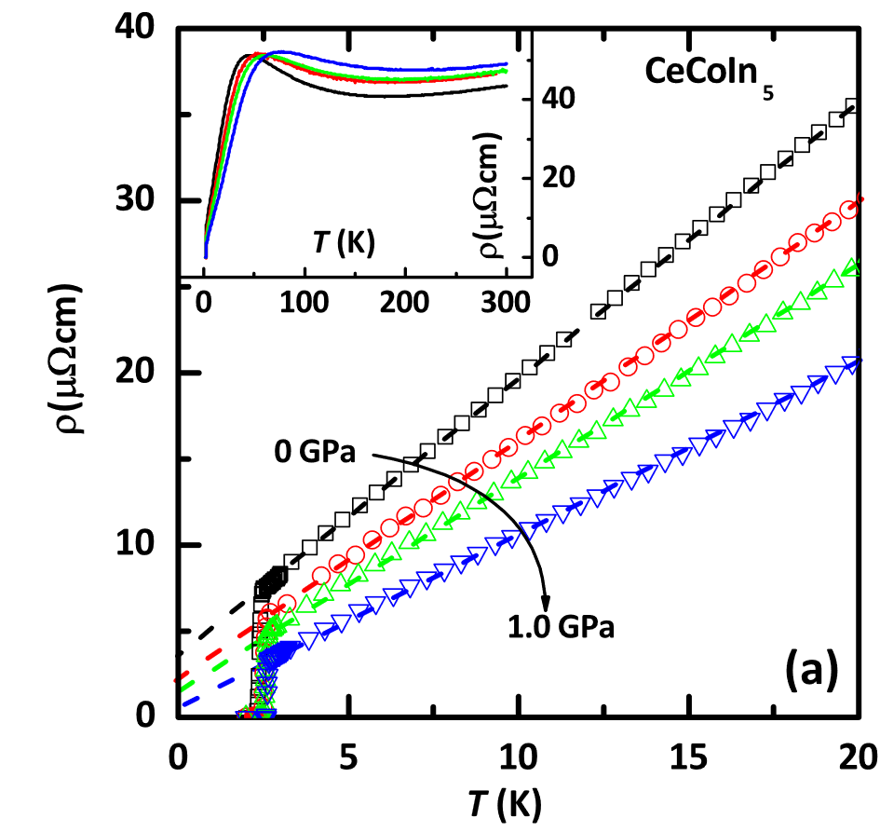
Where can we find them?
Hu et. al. Nature 2017

Slide 14
Where can we find them?
Universal behaviour?
What do they have in common?

Slide 15
Where can we find them?
Unconventional Superconductivity

Slide 16
16
Unconventional Superconductivity
Strange Metal Physics

Slide 17
17
Unconventional Superconductivity
Strange Metal Physics
Antiferromagnetism

Slide 18
18
Connection between Strange Metal physics and Antiferromagnetism?
Strange Metal Physics
Unconventional Superconductivity
?
Antiferromagnetism

Slide 19

19
Are antiferromagnetic fluctuations giving rise to the Planckian scattering rate?
????
$$\frac{1}{τ }=\frac{k_{B}T}{ℏ}$$
Antiferromagnetism

Slide 20
20
Materials:
The isostructural delafossites
PdCoO₂ & PdCrO₂

Slide 21
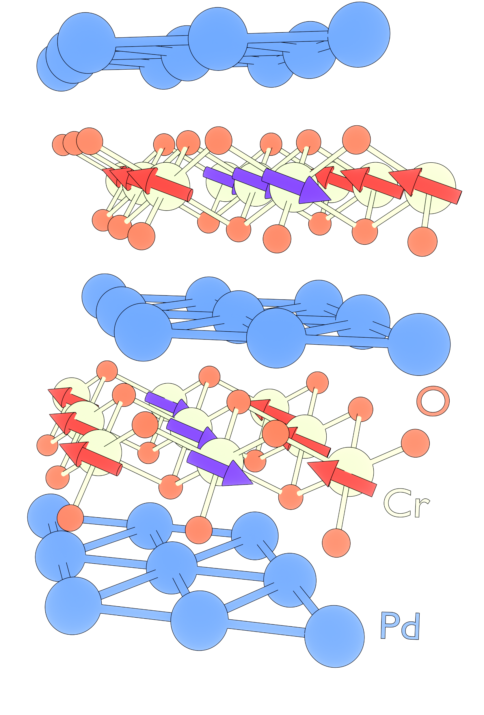
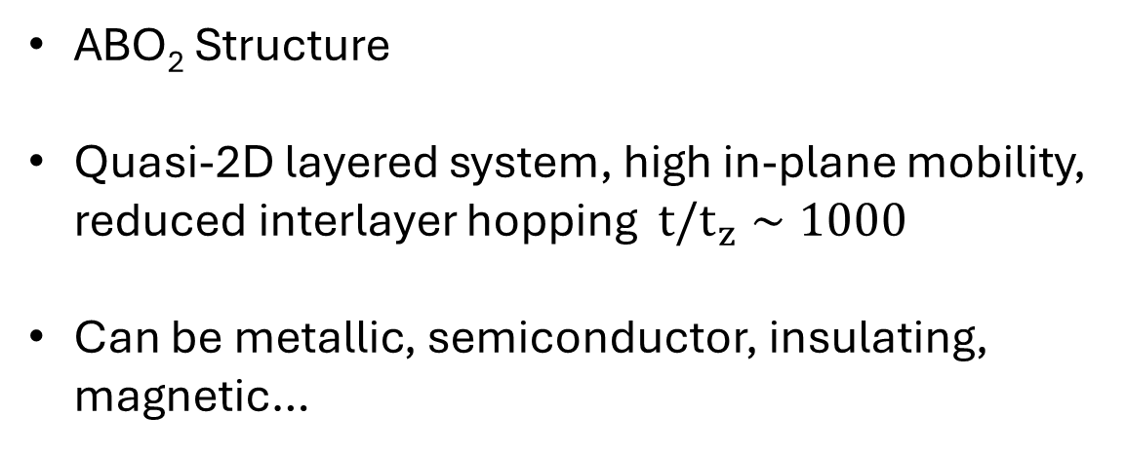
The isostructural delafossites
ABO₂ Structure
Quasi-2D layered system, high in-plane mobility, reduced interlayer hopping ${t/t}_{z}∼1000$
Can be metallic, semiconductor, insulating, magnetic…
Our interest:
PdCoO₂ & PdCrO₂
B
A

Slide 22
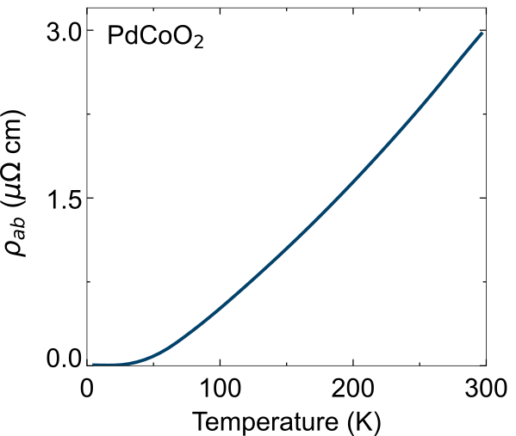
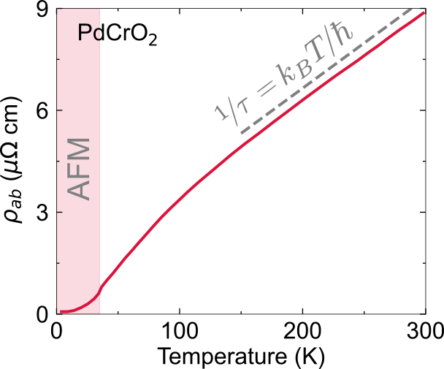
Identical structure, very different resistivity:
22
Zhang et. al.
Nat. Comms, 2024
Zhakina et. al.
PNAS, 2023
PdCrO₂
PdCoO₂

Slide 23
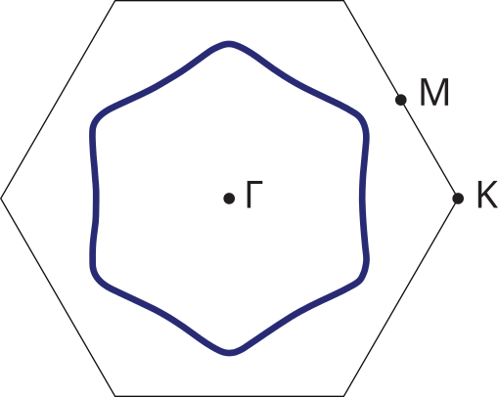
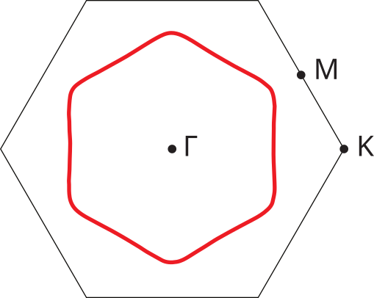
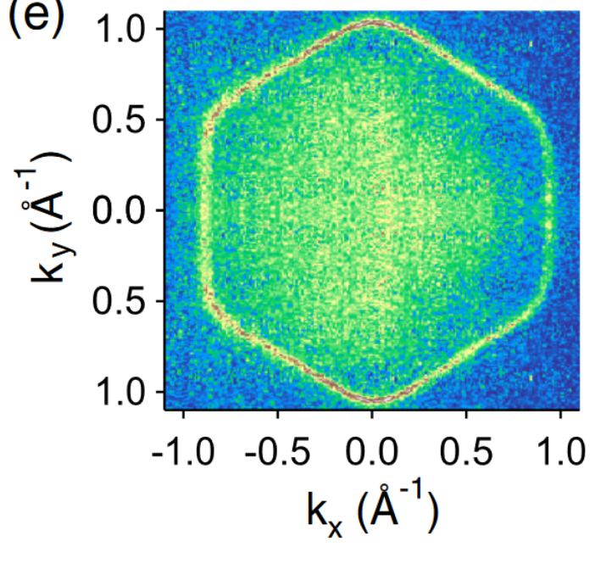
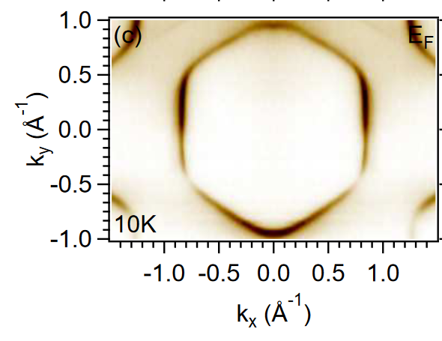
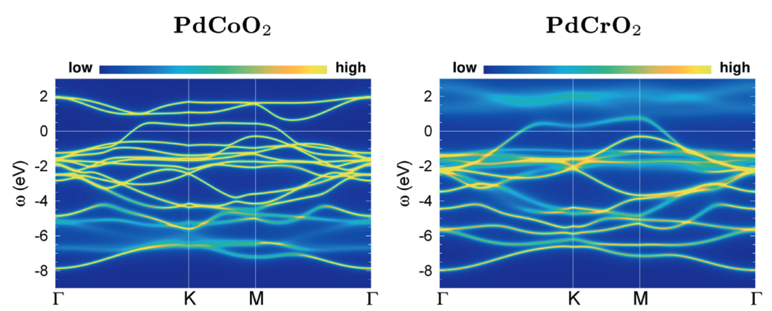
PdCoO₂
23
Identical Fermi Surface $→$ Only difference is $1/τ$
PdCrO₂
Noh et. al.
PRL 102, 256404
Sobota et. al.
PRB 88, 125109
Lechermann, Nat.Comp.Mats, 2021

Slide 24
24
Method:
Angle-Dependent Magneto-Resistance

Slide 25
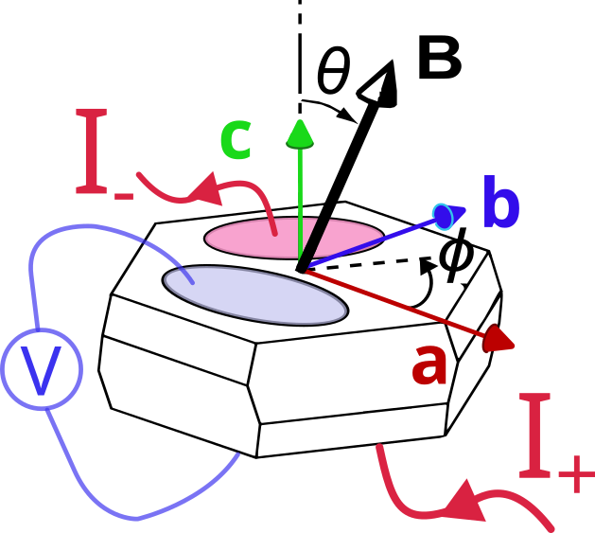
25
C-axis electric transport in a magnetic field

Slide 26
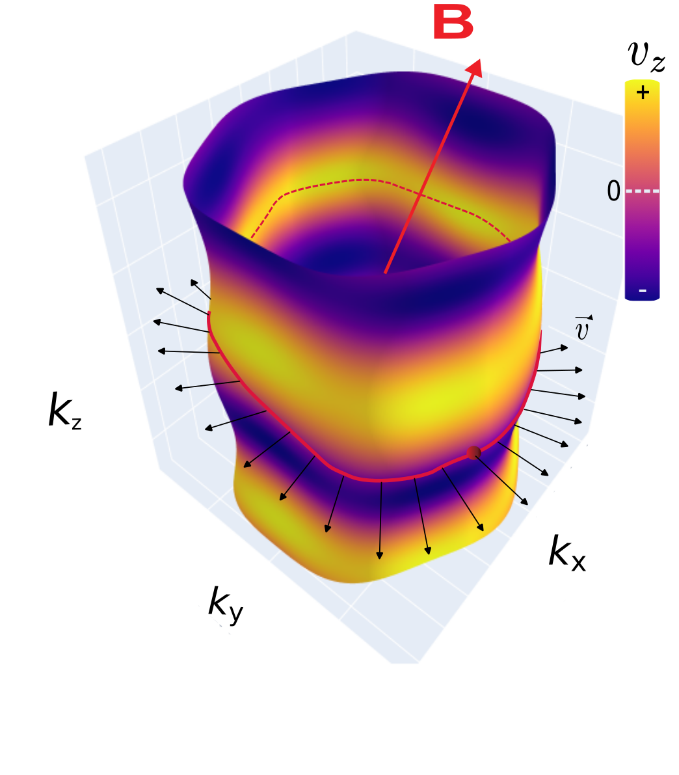
26
Electrons draw orbits in the Fermi surface

Slide 27
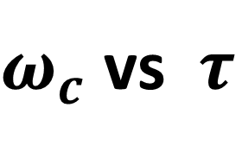
27
Electrons draw orbits in the Fermi surface
$ω_{c}$ vs $τ$

Slide 28
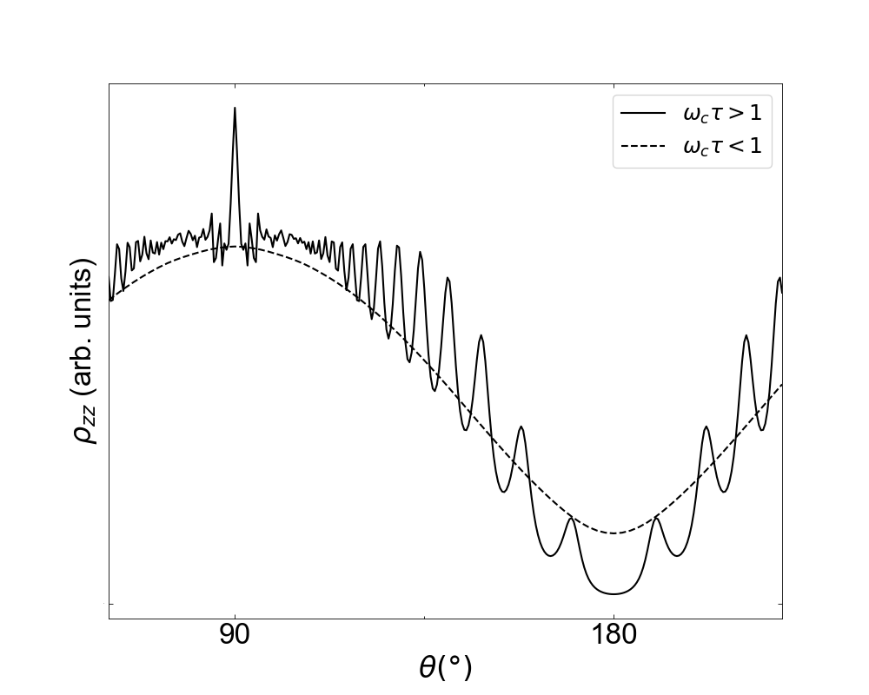
28
Resistivity oscillates due to averaging of velocities along orbits

Slide 29
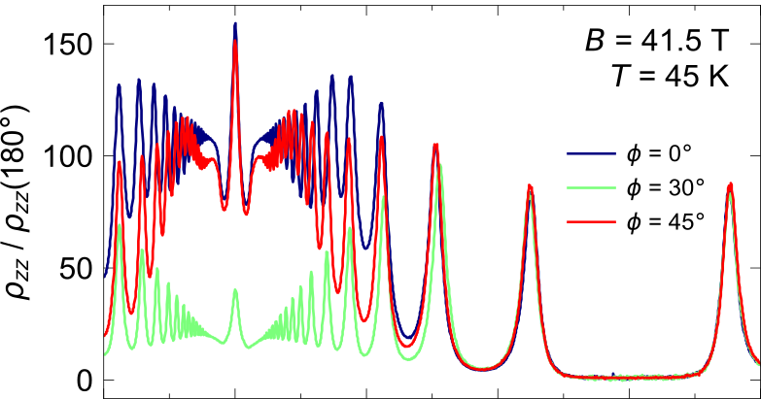
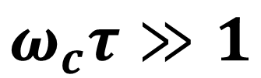
29
Resistivity oscillates due to averaging of velocities along orbits
$$ω_{c}τ≫1$$

Slide 30
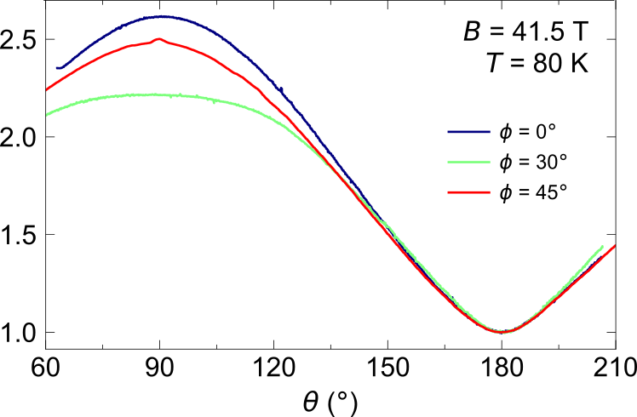
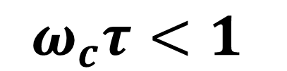
30
Resistivity oscillates due to averaging of velocities along orbits
$$ω_{c}τ<1$$

Slide 31
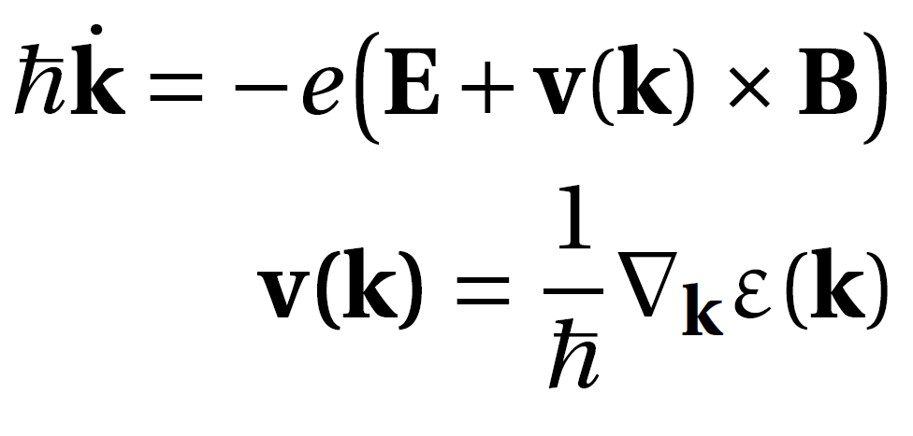
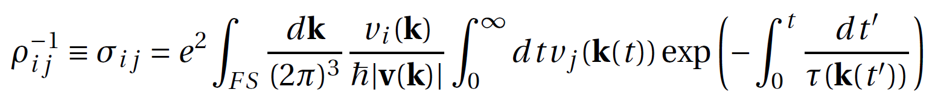
31
Extracting $1/τ$: Chamber’s formula

Slide 32
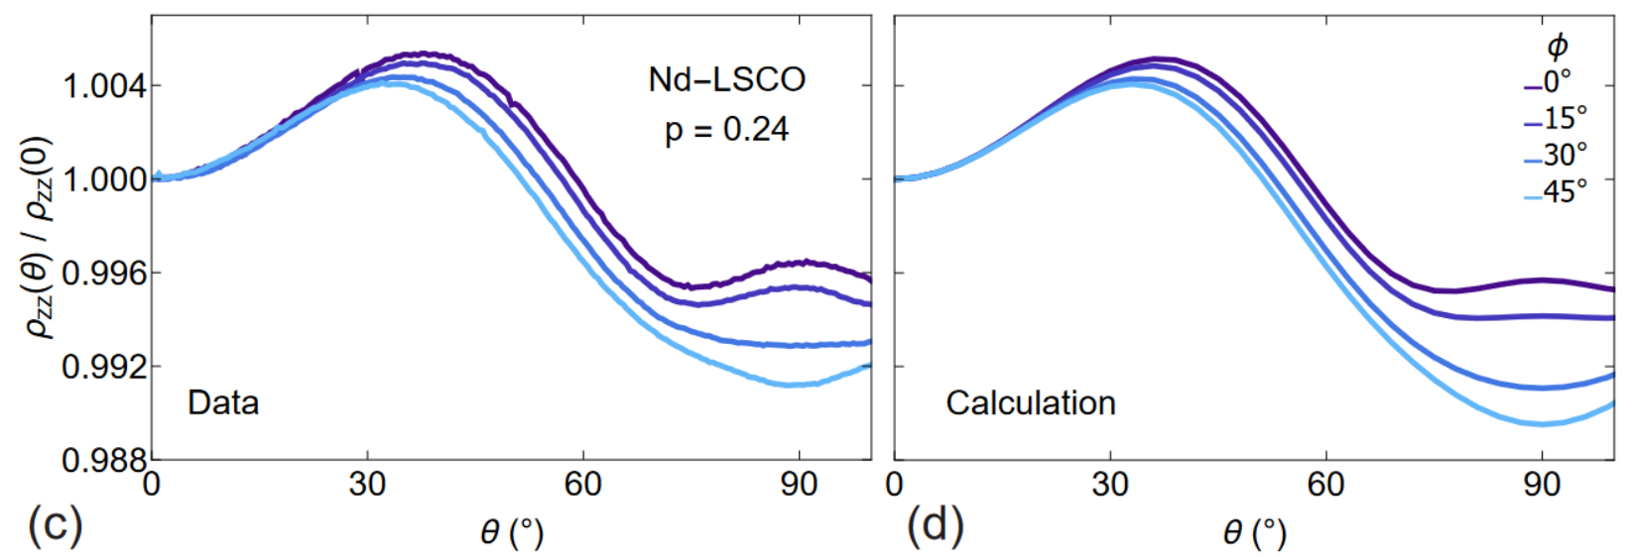
32
Extracting $1/τ$: Chamber’s formula
Grissonnanche et. al.
Nature, 2021

Slide 33
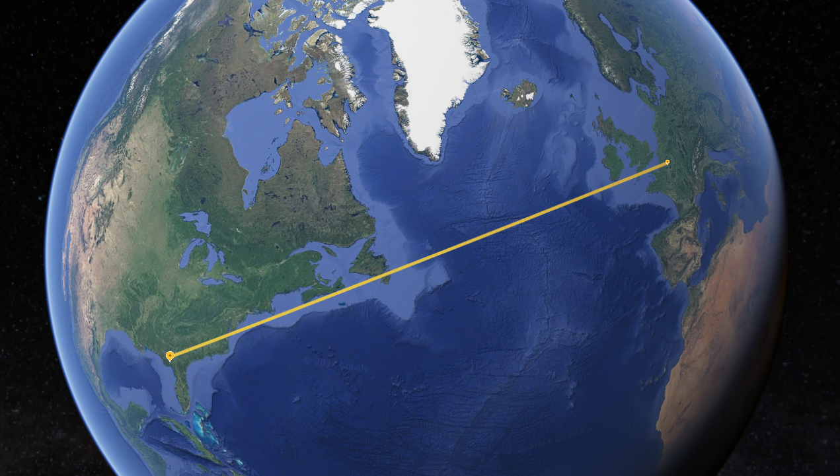

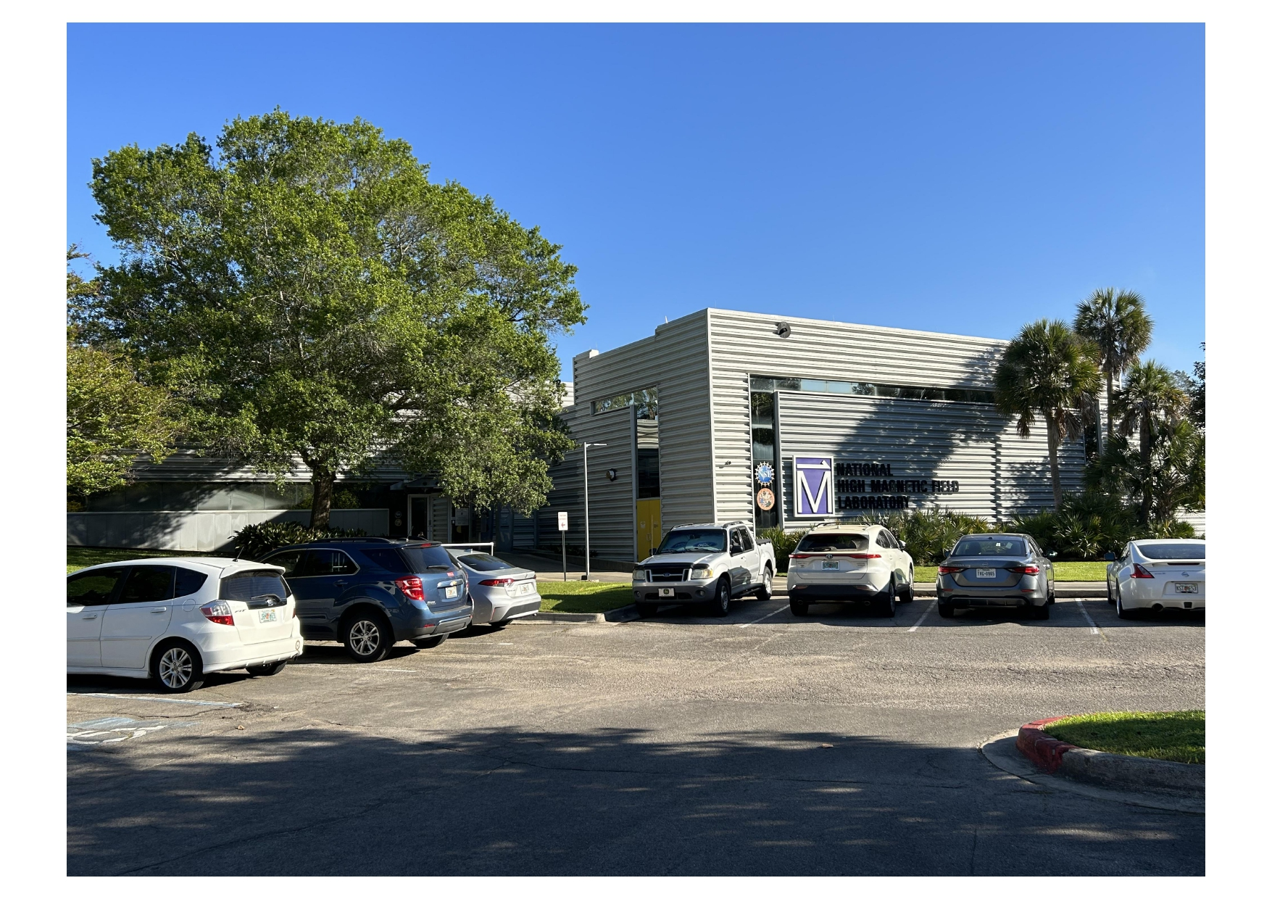
33
Experiment:
Largest resistive continuous magnet in the world
42 Tesla
4 samples
300 L/s for cooling
13 temperatures

Slide 34
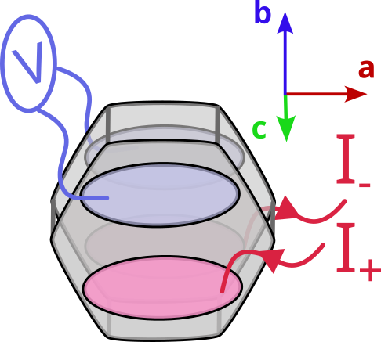
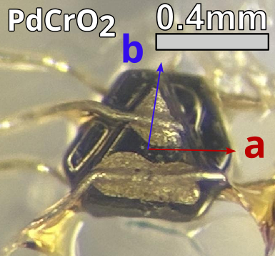
34
Samples

Slide 35
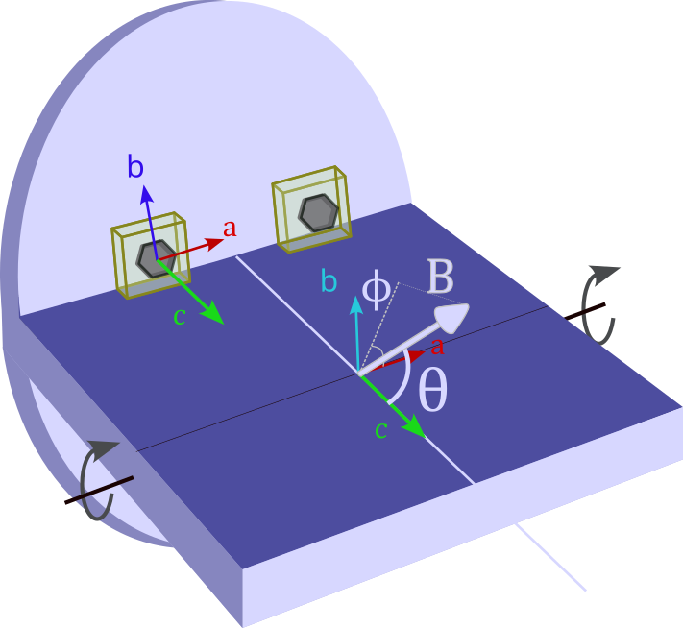


35
Experiment configuration
$$Θ$$
$$φ$$

Slide 36
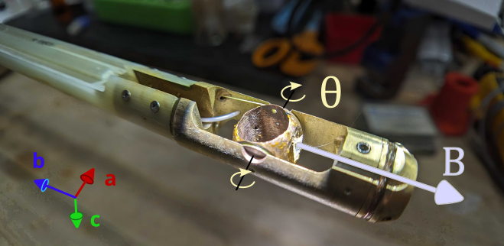


36
Experiment configuration
$$Θ$$
$$φ$$

Slide 37
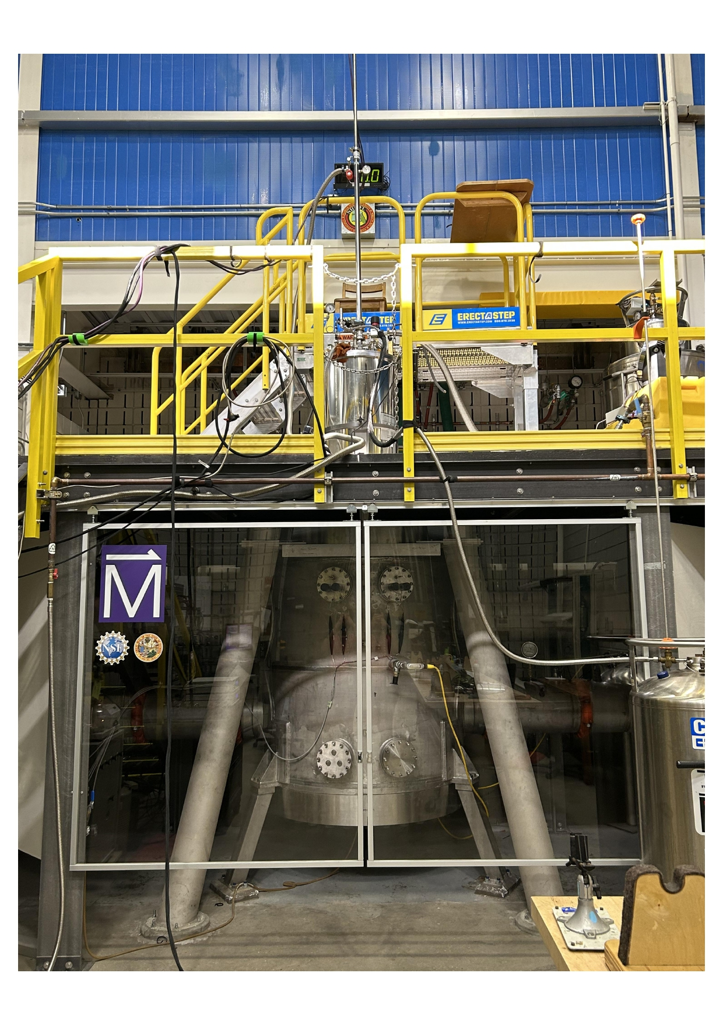
37
Experiment configuration
$$Θ$$
$$φ$$

Slide 38
38
Results

Slide 39
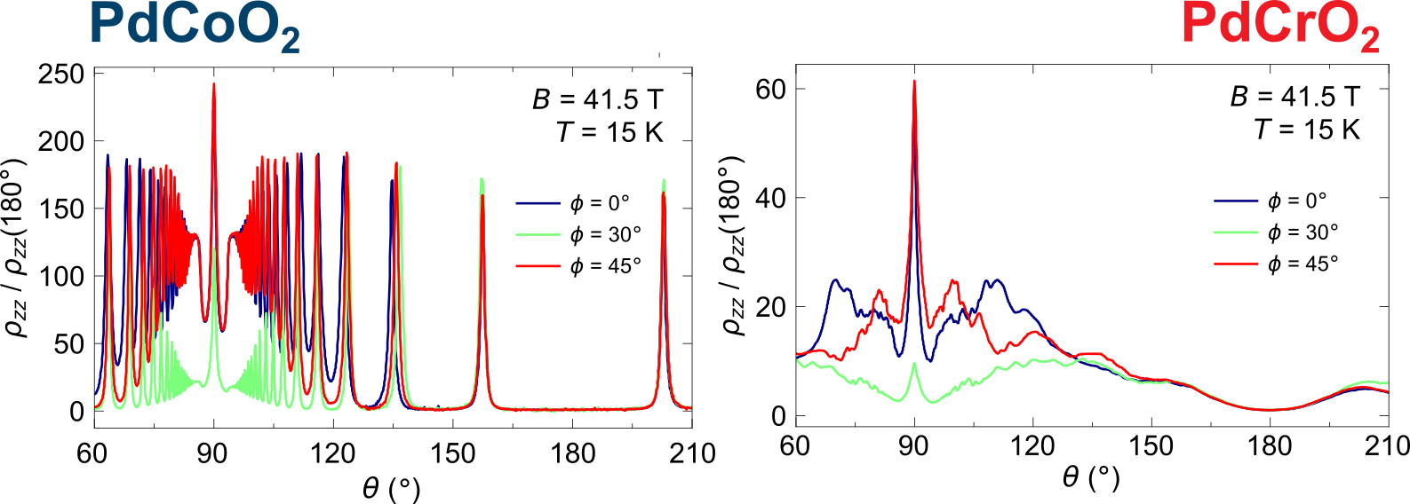

39
Low Temperature: Great differences due to FS folding, but clean oscillations due to $ω_{c}τ≫1$

Slide 40
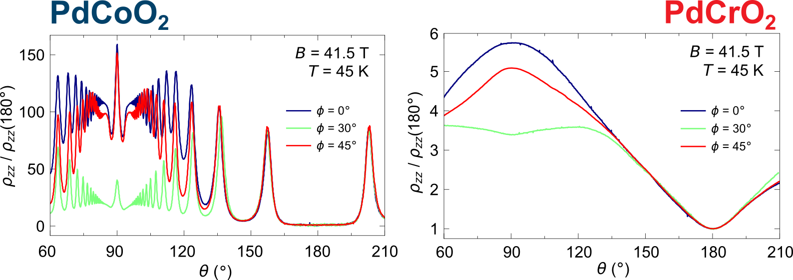
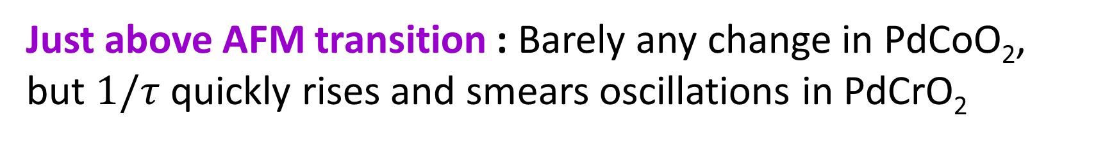

40
Just above AFM transition : Barely any change in PdCoO₂, but $1/τ$ quickly rises and smears oscillations in PdCrO₂
$$ω_{c}τ∼0.7$$

Slide 41
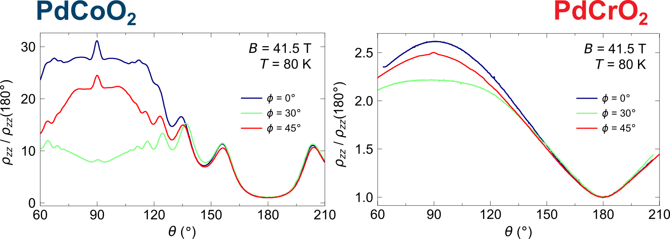
41
High Temperature: In PdCrO₂ all features have dissappeared, PdCoO₂ starts resembling the previous PdCrO₂ data

Slide 42
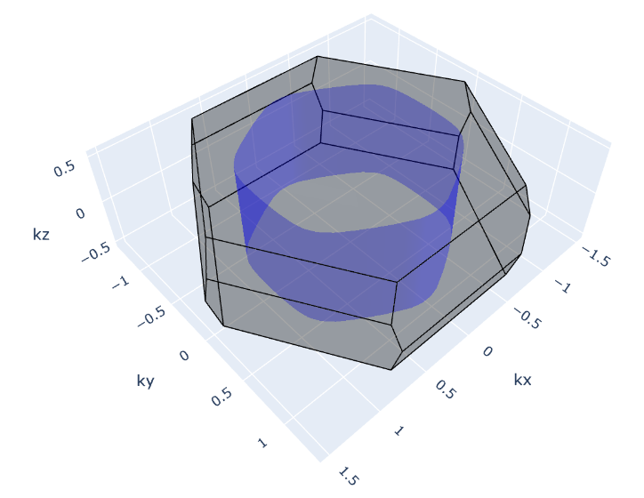
42
Outlook: Transport simulations

Slide 43
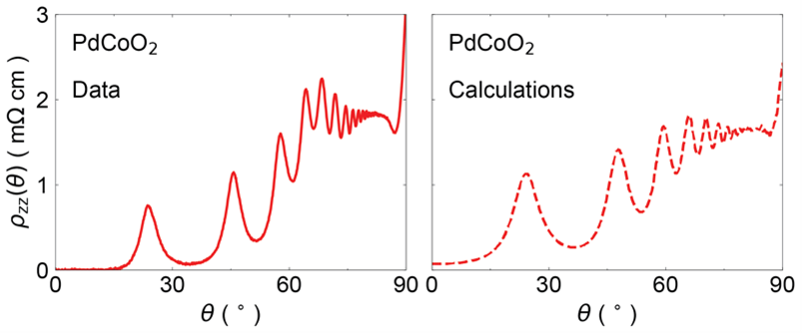
43
Outlook: Transport simulations

Slide 44
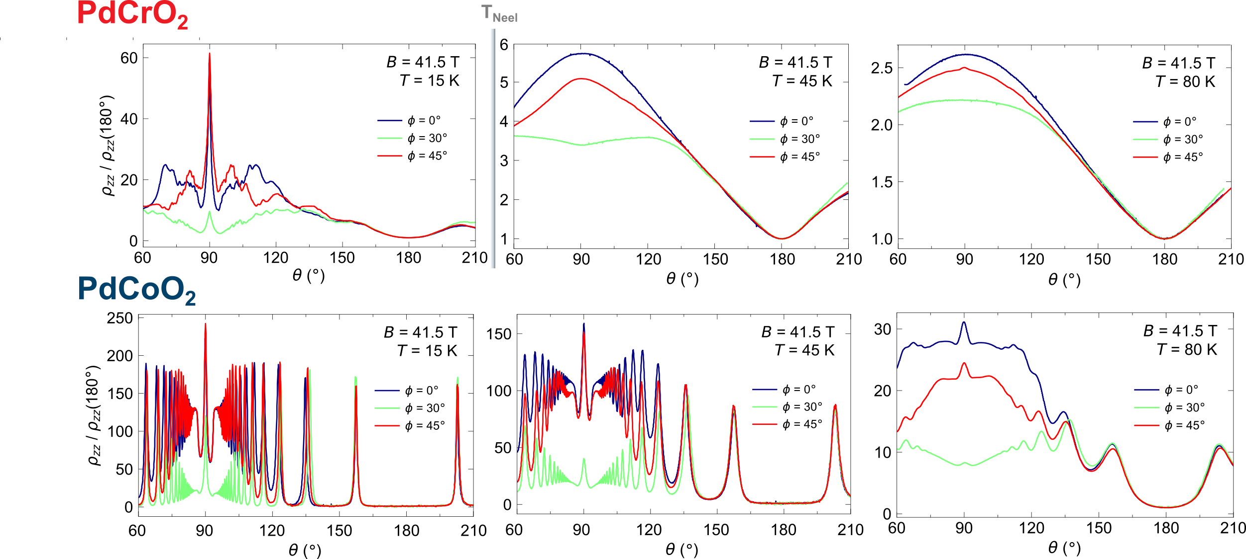
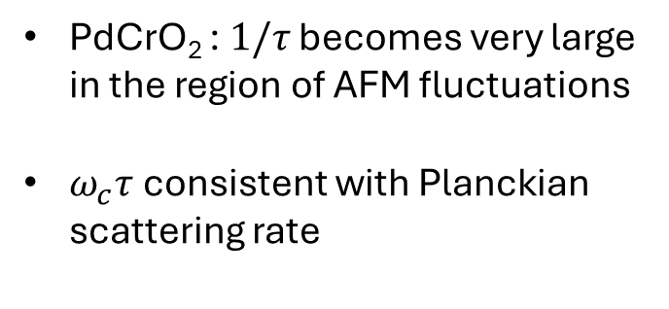

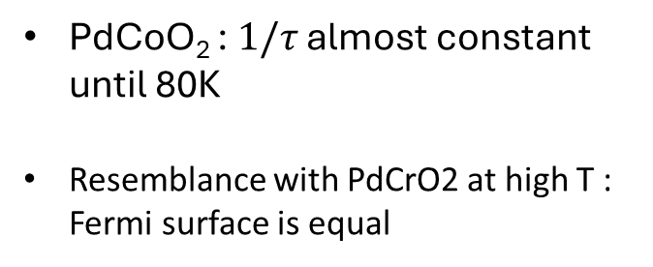
44
Conclusion
PdCrO₂ : $1/τ$ becomes very large in the region of AFM fluctuations
$ω_{c}τ$ consistent with Planckian scattering rate
PdCoO₂ : $1/τ$ almost constant until 80K
Resemblance with PdCrO2 at high T : Fermi surface is equal
$$T_{Neel}$$

Slide 45
45
Thank you!
PdCrO₂ : $1/τ$ becomes very large in the region of AFM fluctuations
$ω_{c}τ$ consistent with Planckian scattering rate
PdCoO₂ : $1/τ$ almost constant until 80K
Resemblance with PdCrO2 at high T : Fermi surface is equal
$$T_{Neel}$$

Slide 46


S1
ADMR as probe of magnetic reconstruction in PdCrO₂
Hicks et. al.
PRB 92, 014425

Slide 47
S1
Validity of the semiclassical framework in Quantum Materials
Many successes:
Description of ADMR
Description of Seebeck coefficient in
Some failures:
Strange Metals magneto-resistance dependence (H-linear)

Slide 48
S1

Slide 49
S1

